Slide 1

CHAPTER 8
RELATIONS
Copyright © Cengage Learning. All rights reserved.

Slide 2
SECTION 8.5
Partial Order Relations
Copyright © Cengage Learning. All rights reserved.

Slide 3
Partial Order Relations
In order to obtain a degree in computer science at a certain university, a student must take a specified set of required courses, some of which must be completed before others can be started.
Given the prerequisite structure of the program, one might ask what is the least number of school terms needed to fulfill the degree requirements, or what is the maximum number of courses that can be taken in the same term, or whether there is a sequence in which a part-time student can take the courses one per term.

Slide 4
Antisymmetry

Slide 5
Antisymmetry
We have defined three properties of relations: reflexivity, symmetry, and transitivity. A fourth property of relations is called antisymmetry.
In terms of the arrow diagram of a relation, saying that a relation is antisymmetric is the same as saying that whenever there is an arrow going from one element to another distinct element, there is not an arrow going back from the second to the first.

Slide 6
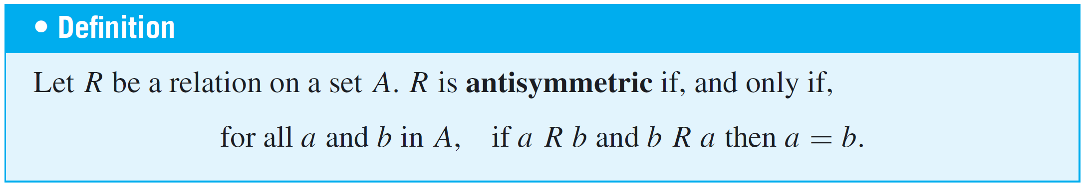
Antisymmetry
By taking the negation of the definition, you can see that a relation R is not antisymmetric if, and only if,
there are elements a and b in A such that a R b and b R a but a ≠ b.

Slide 7
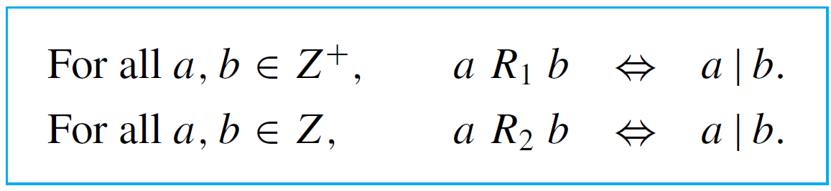
Example 2 – Testing for Antisymmetry of “Divides” Relations
Let R₁ be the “divides” relation on the set of all positive integers, and let R₂ be the “divides” relation on the set of all integers.
a. Is R₁ antisymmetric? Prove or give a counterexample.
b. Is R₂ antisymmetric? Prove or give a counterexample.

Slide 8

Example 2 – Solution
a. R₁ is antisymmetric.
Proof:
Suppose a and b are positive integers such that a R₁ b and b R₁ a. [We must show that a = b.] By definition of R₁, a | b and b | a.
Thus, by definition of divides, there are integers k₁ and k₂ with b = k₁a and a = k₂b. It follows that
Dividing both sides by b gives

Slide 9


Example 2 – Solution
cont’d
Now since a and b are both integers k₁ and k₂ are both positive integers also.
But the only product of two positive integers that equals 1 is 1  1.
Thus
and so
[This is what was to be shown.]

Slide 10
Example 2 – Solution
cont’d
b. R₂ is not antisymmetric.
Counterexample:
Let a = 2 and b = –2. Then a | b [since –2 = (–1)  2] and
b | a [since 2 = (–1)(–2)].
Hence a R₂ b and b R₂ a but a ≠ b.

Slide 11
Partial Order Relations

Slide 12
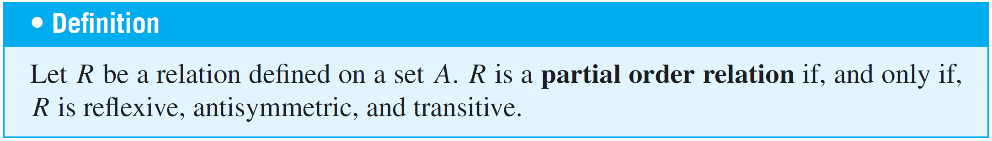
Partial Order Relations
A relation that is reflexive, antisymmetric, and transitive is called a partial order.
Two fundamental partial order relations are the “less than or equal to” relation on a set of real numbers and the “subset” relation on a set of sets.
These can be thought of as models, or paradigms, for general partial order relations.

Slide 13
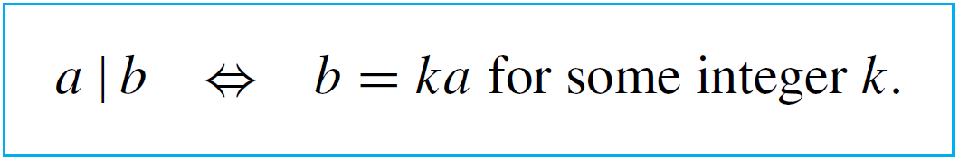
Example 4 – A “Divides” Relation on a Set of Positive Integers
Let | be the “divides” relation on a set A of positive integers. That is, for all a, b ∈ A,
Prove that | is a partial order relation on A.
Solution:
| is reflexive: [We must show that for all a ∈ A, a | a.] Suppose a ∈ A. Then a = 1  a, so a | a by definition of divisibility.

Slide 14
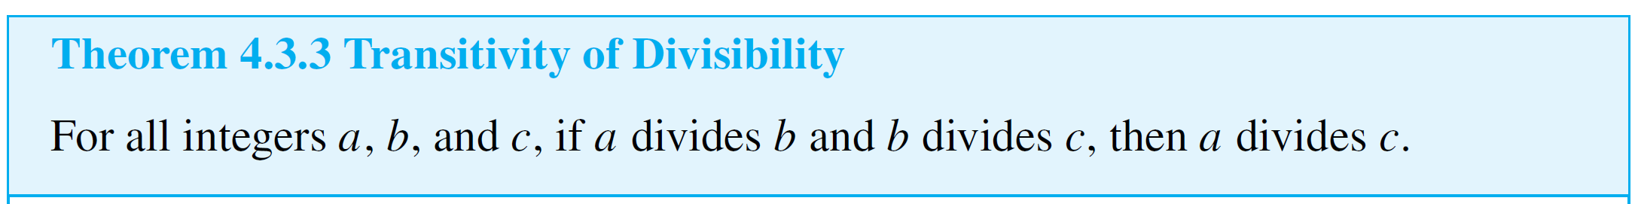
Example 4 – Solution
cont’d
| is antisymmetric: [We must show that for all a, b ∈ A, if
a | b and b | a then a = b.] The proof of this is virtually identical to that of Example 2(a).
| is transitive: To show transitivity means to show that for all a, b, c ∈ A, if a | b and b | c then a | c. But this was proved as Theorem 4.3.3.
Since | is reflexive, antisymmetric, and transitive, | is a partial order relation on A.

Slide 15
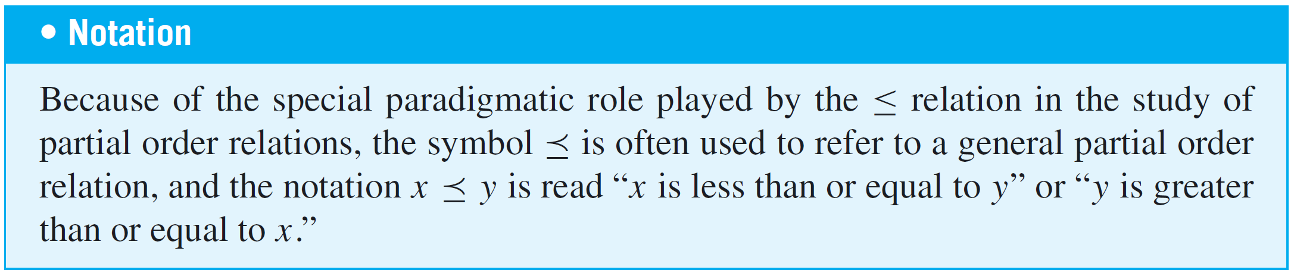
Partial Order Relations

Slide 16
Lexicographic Order

Slide 17
Lexicographic Order
To figure out which of two words comes first in an English dictionary, you compare their letters one by one from left to right. If all letters have been the same to a certain point and one word runs out of letters, that word comes first in the dictionary.
For example, play comes before playhouse. If all letters up to a certain point are the same and the next letters differ, then the word whose next letter is located earlier in the alphabet comes first in the dictionary. For instance, playhouse comes before playmate.

Slide 18
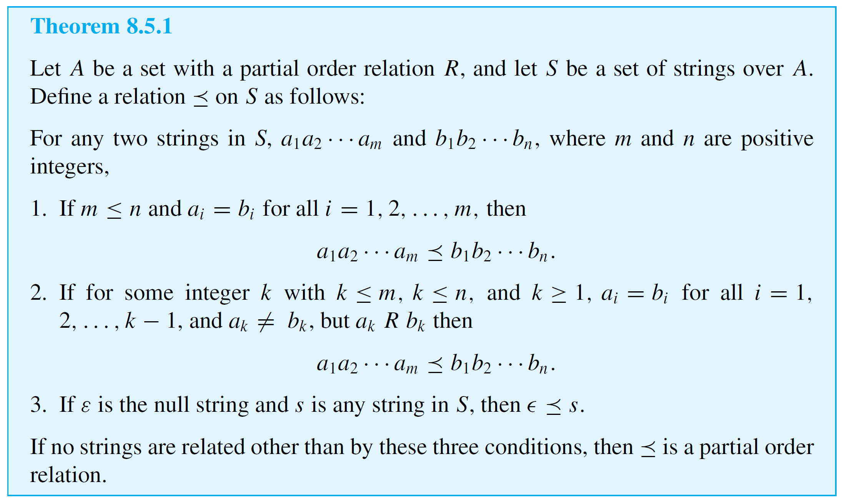
Lexicographic Order
More generally, if A is any set with a partial order relation, then a dictionary or lexicographic order can be defined on a set of strings over A as indicated in the following theorem.

Slide 19
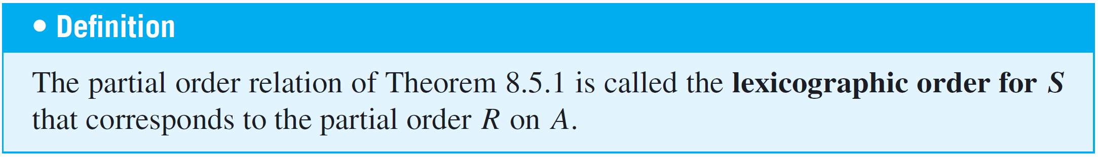
Lexicographic Order

Slide 20

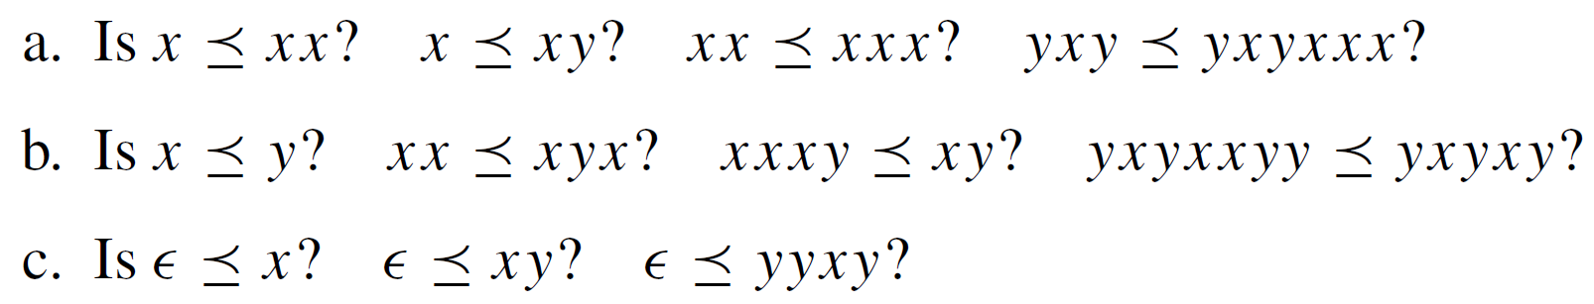
Example 6 – A Lexicographic Order
Let A = {x, y} and let R be the following partial order relation on A:
Let S be the set of all strings over A, and denote by the lexicographic order for S that corresponds to R.
a.
b.
c.

Slide 21
Example 6 – Solution
a. Yes in all cases, by relation (1) in theorem 8.5.1.
b. Yes in all cases, by relation (2) in theorem 8.5.1.
c. Yes in all cases, by relation (3) in theorem 8.5.1.

Slide 22
Hasse Diagrams

Slide 23
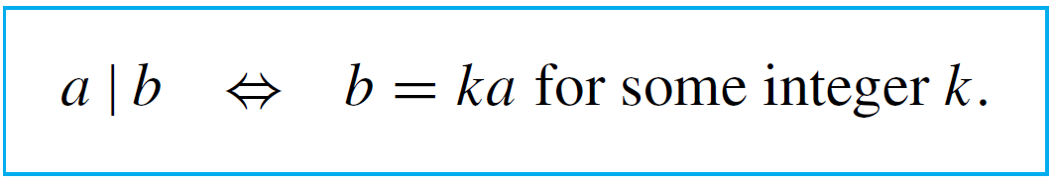
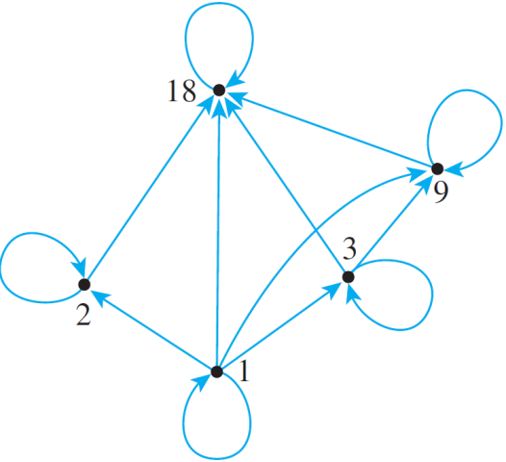
Hasse Diagrams
Let A = {1, 2, 3, 9, 18} and consider the “divides” relation
on A: For all a, b ∈ A,
The directed graph of this relation has the following appearance:

Slide 24
Hasse Diagrams
Note that there is a loop at every vertex, all other arrows point in the same direction (upward), and any time there is an arrow from one point to a second and from the second point to a third, there is an arrow from the first point to the third.
Given any partial order relation defined on a finite set, it is possible to draw the directed graph in such a way that all of these properties are satisfied.

Slide 25
Hasse Diagrams
This makes it possible to associate a somewhat simpler graph, called a Hasse diagram (after Helmut Hasse, a twentieth-century German number theorist), with a partial order relation defined on a finite set.
To obtain a Hasse diagram, proceed as follows:
Start with a directed graph of the relation, placing vertices on the page so that all arrows point upward. Then eliminate
1. the loops at all the vertices,

Slide 26
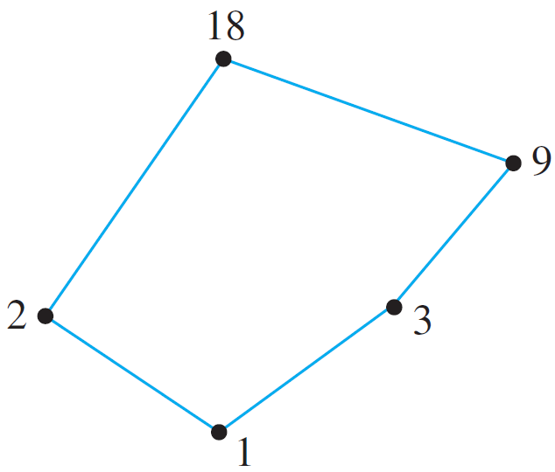
Hasse Diagrams
2. all arrows whose existence is implied by the transitive
property,
3. the direction indicators on the arrows.
For the relation given previously, the Hasse diagram is as follows:

Slide 27

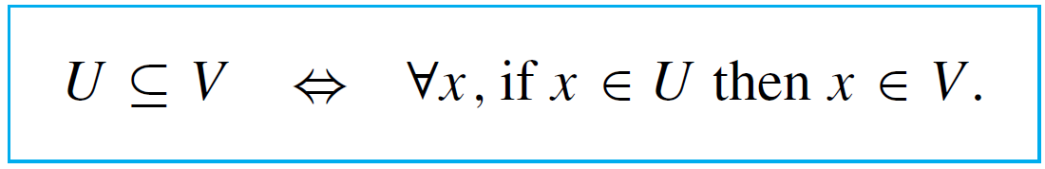
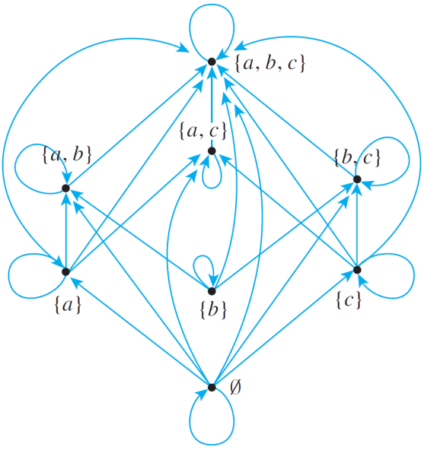
Example 7 – Constructing a Hasse Diagram
Consider the “subset” relation, ⊆, on the set ({a, b, c}). That is, for all sets U and V in ({a, b, c}),
Construct the Hasse diagram for this relation.
Solution:
Draw the directed graph of
the relation in such a way
that all arrows except loops
point upward.

Slide 28
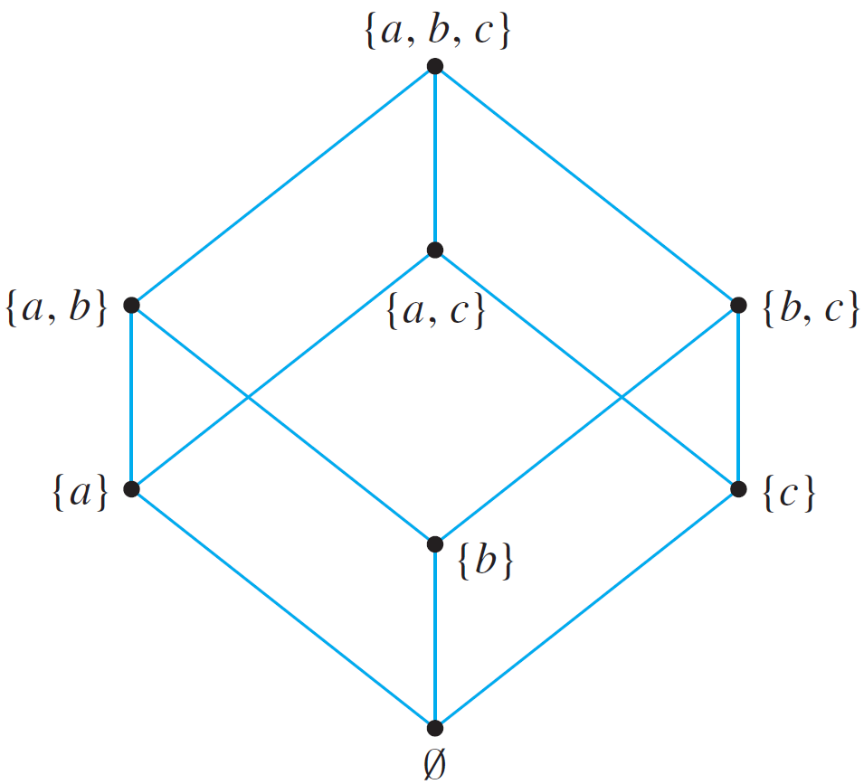
Example 7 – Solution
cont’d
Then strip away all loops, unnecessary arrows, and direction indicators to obtain the Hasse diagram.

Slide 29
Hasse Diagrams
To recover the directed graph of a relation from the Hasse diagram, just reverse the instructions given previously, using the knowledge that the original directed graph was sketched so that all arrows pointed upward:
1. Reinsert the direction markers on the arrows making all
arrows point upward.
2. Add loops at each vertex.
3. For each sequence of arrows from one point to a second
and from that second point to a third, add an arrow from
the first point to the third.

Slide 30
Partially and Totally Ordered Sets

Slide 31


Partially and Totally Ordered Sets
Given any two real numbers x and y, either x ≤ y or y ≤ x. In a situation like this, the elements x and y are said to be comparable.
On the other hand, given two subsets A and B of {a, b, c}, it may be the case that neither A ⊆ B nor B ⊆ A.
For instance, let A = {a, b} and B = {b, c}. Then and
In such a case, A and B are said to be noncomparable.

Slide 32
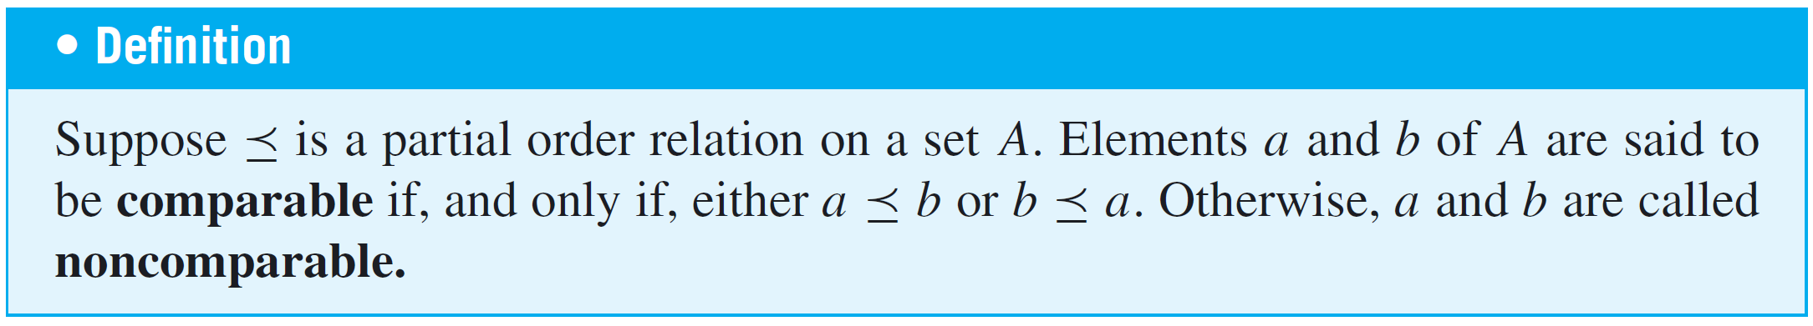
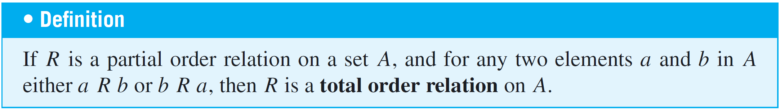
Partially and Totally Ordered Sets
When all the elements of a partial order relation are comparable, the relation is called a total order.

Slide 33
Partially and Totally Ordered Sets
Both the “less than or equal to” relation on sets of real numbers and the lexicographic order of the set of words in a dictionary are total order relations.
Note that the Hasse diagram for a total order relation can be drawn as a single vertical “chain.”
Many important partial order relations have elements that are not comparable and are, therefore, not total order relations.

Slide 34

Partially and Totally Ordered Sets
For instance, the subset relation on ({a, b, c}) is not a total order relation because, as shown previously, the subsets {a, b} and {a, c} of {a, b, c} are not comparable.
In addition, a “divides” relation is not a total order relation unless the elements are all powers of a single integer.
A set A is called a partially ordered set (or poset) with respect to a relation if, and only if, is a partial order relation on A.

Slide 35
Partially and Totally Ordered Sets
For instance, the set of real numbers is a partially ordered set with respect to the “less than or equal to” relation ≤, and a set of sets is partially ordered with respect to the “subset” relation ⊆.
It is entirely straightforward to show that any subset of a partially ordered set is partially ordered.
This, of course, assumes the “same definition” for the relation on the subset as for the set as a whole. A set A is called a totally ordered set with respect to a relation if, and only if, A is partially ordered with respect to and is a total order.

Slide 36
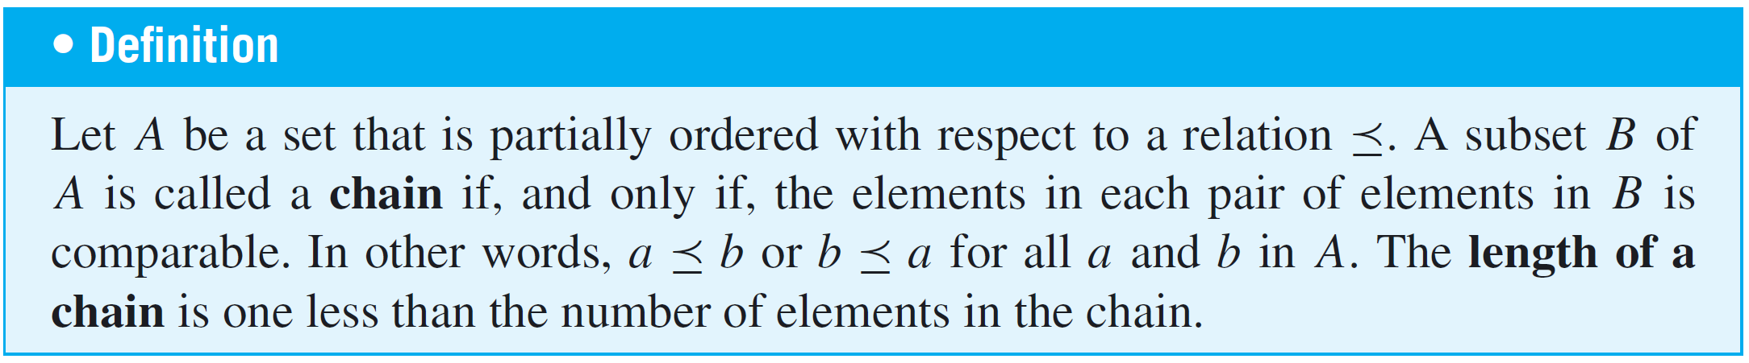
Partially and Totally Ordered Sets
A set that is partially ordered but not totally ordered may have totally ordered subsets. Such subsets are called chains.
Observe that if B is a chain in A, then B is a totally ordered set with respect to the “restriction” of to B.

Slide 37

Example 9 – A Chain of Subsets
The set is partially ordered with respect to the subset relation. Find a chain of length 3 in
Solution:
Since the set
is a chain of length 3 in

Slide 38
Partially and Totally Ordered Sets
A maximal element in a partially ordered set is an element that is greater than or equal to every element to which it is comparable. (There may be many elements to which it is not comparable.)
A greatest element in a partially ordered set is an element that is greater than or equal to every element in the set (so it is comparable to every element in the set). Minimal and least elements are defined similarly.

Slide 39
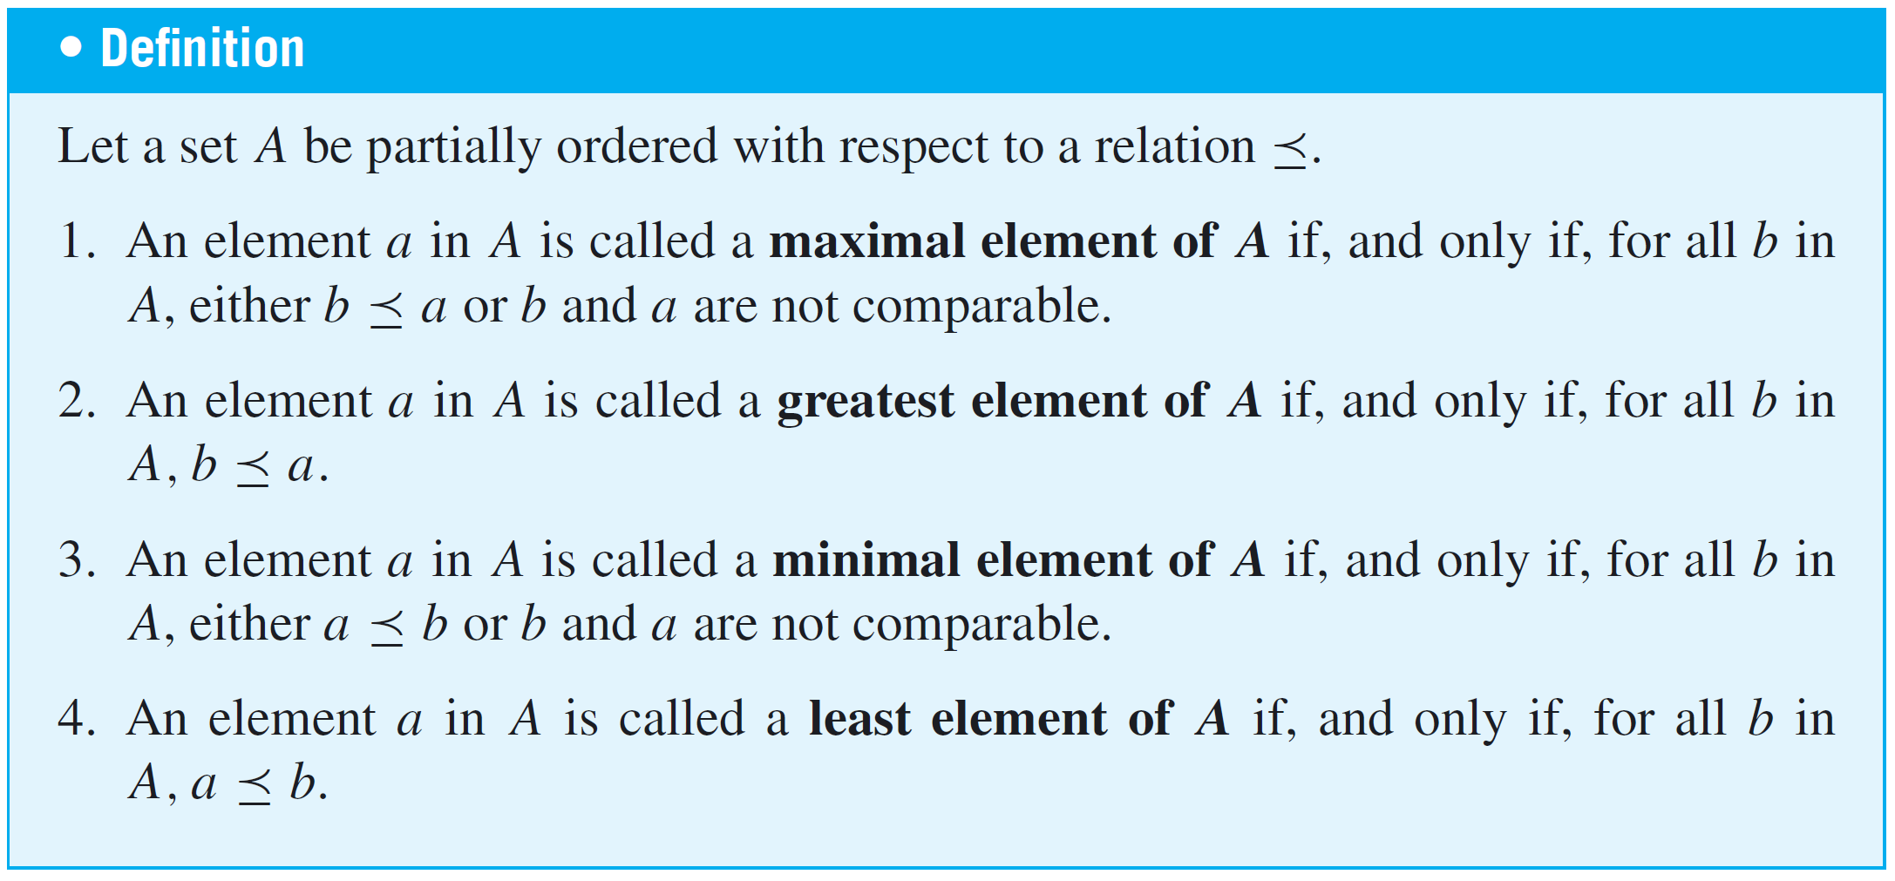
Partially and Totally Ordered Sets

Slide 40
Partially and Totally Ordered Sets
A greatest element is maximal, but a maximal element need not be a greatest element. However, every finite subset of a totally ordered set has both a least element and a greatest element.
Similarly, a least element is minimal, but a minimal element need not be a least element. Furthermore, a set that is partially ordered with respect to a relation can have at most one greatest element and one least element, but it may have more than one maximal or minimal element.

Slide 41
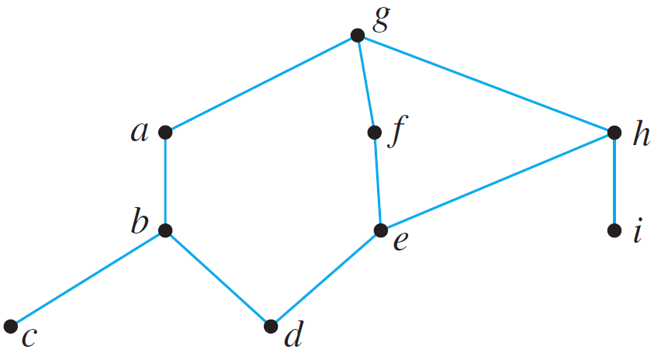
Example 10 – Maximal, Minimal, Greatest, and Least Elements
Let A = {a, b, c, d, e, f, g, h, i } have the partial ordering defined by the following Hasse diagram. Find all maximal, minimal, greatest, and least elements of A.
Solution:
There is just one maximal element, g, which is also the greatest element. The minimal elements are c, d, and i, and there is no least element.

Slide 42
Topological Sorting

Slide 43
Topological Sorting
Is it possible to input the sets of into a computer in a way that is compatible with the subset relation ⊆ in the sense that if set U is a subset of set V, then U is input
before V?
The answer, as it turns out, is yes. For instance, the
following input order satisfies the given condition:
Another input order that satisfies the condition is

Slide 44
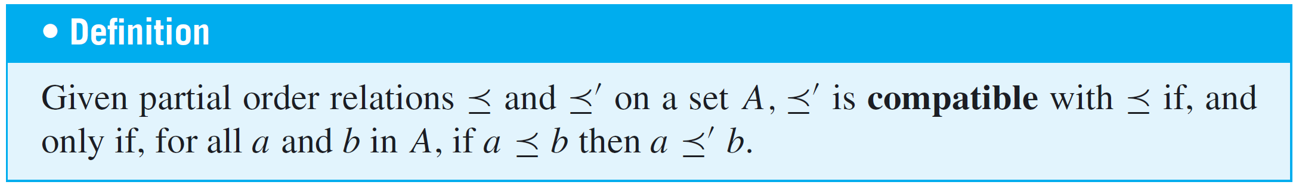


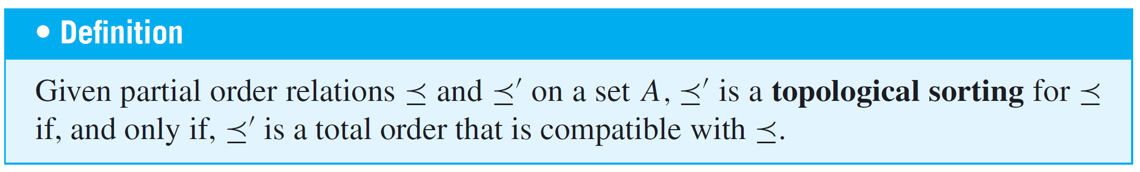
Topological Sorting
Given an arbitrary partial order relation on a set A, is there a total order on A that is compatible with ? If the set on which the partial order is defined is finite, then the answer is yes. A total order that is compatible with a given order is called a topological sorting.

Slide 45
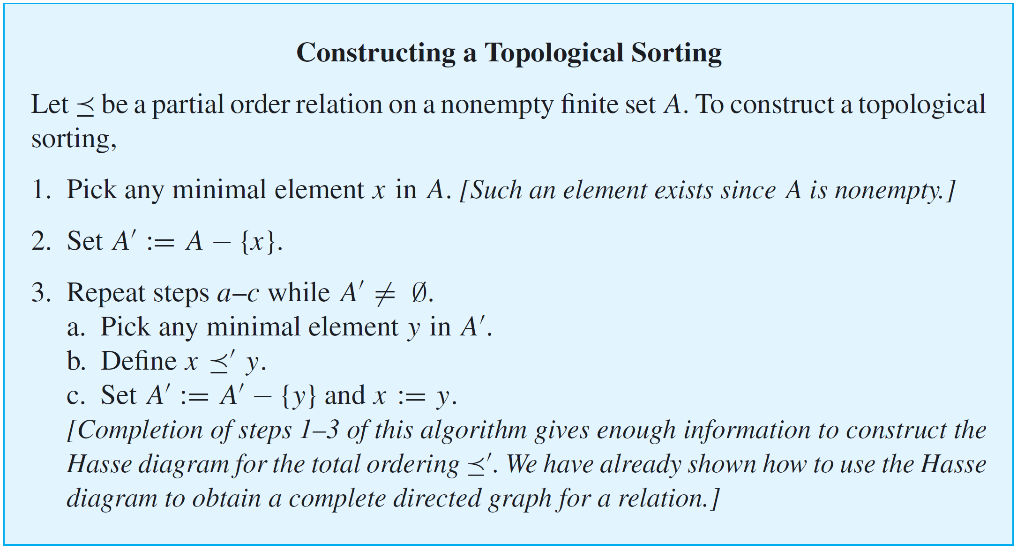
Topological Sorting

Slide 46
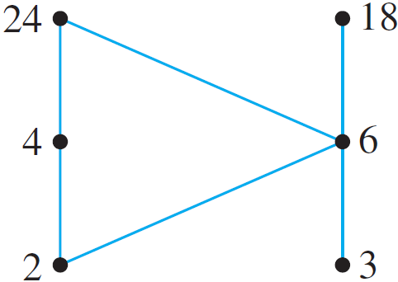
Example 11 – A Topological Sorting
Consider the set A = {2, 3, 4, 6, 18, 24} ordered by the “divides” relation |.
The Hasse diagram of this relation is the following:
The ordinary “less than or equal to” relation ≤ on this set is a topological sorting for it since for positive integers a and b, if a | b then a ≤ b. Find another topological sorting for this set.

Slide 47

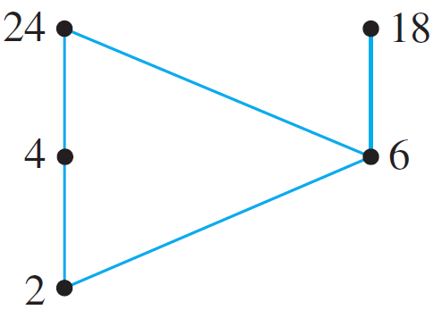
Example 11 – Solution
The set has two minimal elements: 2 and 3. Either one may be chosen; say you pick 3. The beginning of the total order is
total order: 3.
Set You can indicate this by removing 3 from the Hasse diagram as shown below.

Slide 48


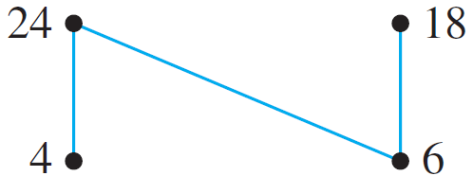

Example 11 – Solution
cont’d
Next choose minimal element from . Only 2 is
minimal, so you must pick it. The total order thus far is
total order: 3 2.
Set .
You can indicate this by removing 2 from the Hasse diagram, as is shown below.
Choose a minimal element from

Slide 49
Example 11 – Solution
cont’d
Again you have two choices: 4 and 6. Say you pick 6. The total order for the elements chosen thus far is
total order: 3 2 6.
You continue in this way until every element of A has been picked. One possible sequence of choices gives
total order: 3 2 6 18 4 24.

Slide 50
Example 11 – Solution
cont’d
You can verify that this order is compatible with the “divides” partial order by checking that for each pair of elements a and b in A such that a | b, then a b.
Note that it is not the case that if a b then a | b.

Slide 51
An Application

Slide 52
An Application
To return to the example that introduced this section, note that the following defines a partial order relation on the set of courses required for a university degree: For all required courses x and y,
If the Hasse diagram for the relation is drawn, then the questions raised at the beginning of this section can be answered easily.

Slide 53
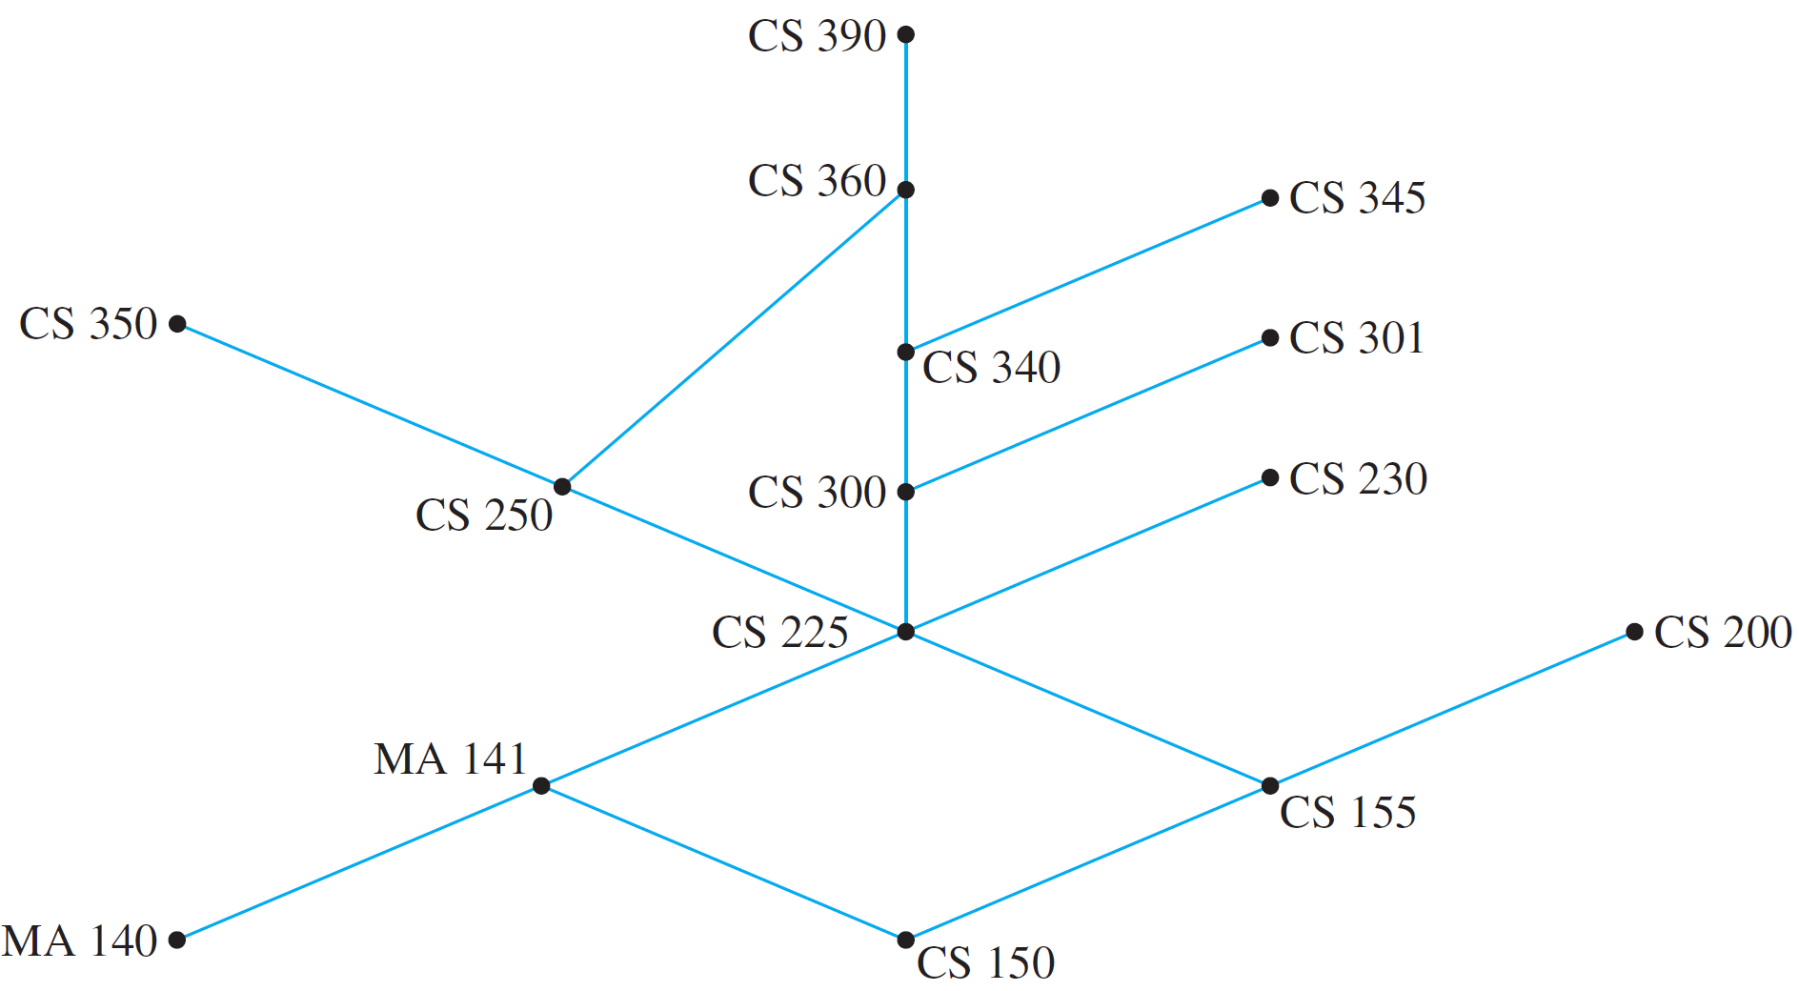
An Application
For instance, consider the Hasse diagram for the requirements at a particular university, which is shown in Figure 8.5.1.
Figure 8.5.1

Slide 54
An Application
The minimum number of school terms needed to complete the requirements is the size of a longest chain, which is 7 (150, 155, 225, 300, 340, 360, 390, for example).
The maximum number of courses that could be taken in the same term (assuming the university allows it) is the maximum number of noncomparable courses, which is 6 (350, 360, 345, 301, 230, 200, for example).

Slide 55
An Application
A part-time student could take the courses in a sequence determined by constructing a topological sorting for the set.
(One such sorting is 140, 150, 141, 155, 200, 225, 230, 300, 250, 301, 340, 345, 350, 360, 390. There are many others.)

Slide 56
PERT and CPM

Slide 57
PERT and CPM
Two important and widely used applications of partial order relations are PERT (Program Evaluation and Review Technique) and CPM (Critical Path Method).
These techniques came into being in the 1950s as planners came to grips with the complexities of scheduling the individual activities needed to complete very large projects, and although they are very similar, their developments were independent.

Slide 58
PERT and CPM
PERT was developed by the U.S.
Navy to help organize the construction of the Polaris submarine, and CPM was developed by the E. I. Du Pont de Nemours company for scheduling chemical plant maintenance.
Here is a somewhat simplified example of the way the techniques work.

Slide 59
Example 12 – A Job Scheduling Problem
At an automobile assembly plant, the job of assembling an automobile can be broken down into these tasks:
1. Build frame.
2. Install engine, power train components, gas tank.
3. Install brakes, wheels, tires.
4. Install dashboard, floor, seats.

Slide 60
Example 12 – A Job Scheduling Problem
cont’d
5. Install electrical lines.
6. Install gas lines.
7. Install brake lines.
8. Attach body panels to frame.
9. Paint body.
Certain of these tasks can be carried out at the same time, whereas some cannot be started until other tasks are finished.

Slide 61
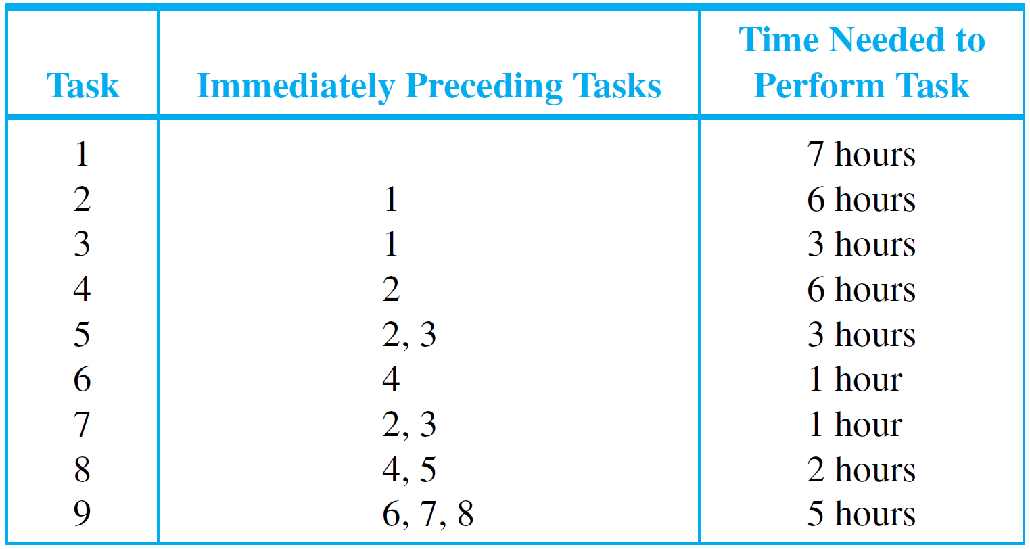
Example 12 – A Job Scheduling Problem
cont’d
Table 8.5.1 summarizes the order in which tasks can be performed and the time required to perform each task.
Table 8.5.1

Slide 62

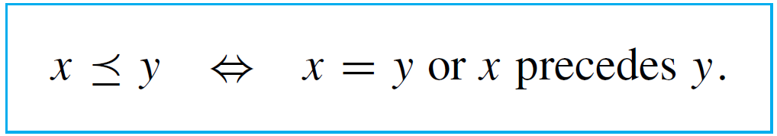
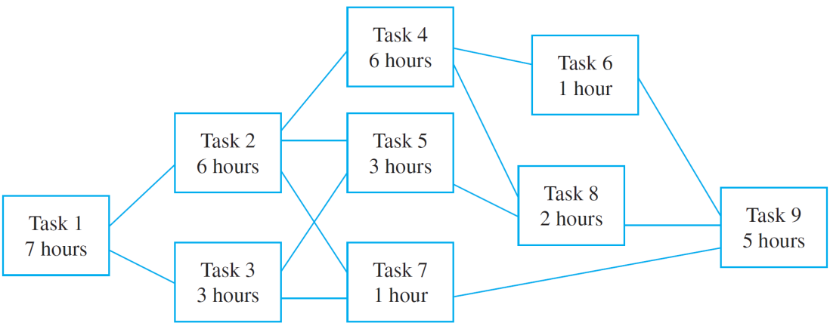
Example 12 – A Job Scheduling Problem
cont’d
Let T be the set of all tasks, and consider the partial order relation defined on T as follows: For all tasks x and y in
T,
If the Hasse diagram of this relation is turned sideways (as is customary in PERT and CPM analysis), it has the appearance shown below.

Slide 63
Example 12 – A Job Scheduling Problem
cont’d
What is the minimum time required to assemble a car? You can determine this by working from left to right across the diagram, noting for each task (say, just above the box representing that task) the minimum time needed to complete that task starting from the beginning of the assembly process.
For instance, you can put a 7 above the box for task 1 because task 1 requires 7 hours.
Task 2 requires completion of task 1 (7 hours) plus 6 hours for itself, so the minimum time required to complete task 2, starting at the beginning of the assembly process, is
7 + 6 = 13 hours.

Slide 64
Example 12 – A Job Scheduling Problem
cont’d
You can put a 13 above the box for task 2.
Similarly, you can put a 10 above the box for task 3 because 7 + 3 = 10.
Now consider what number you should write above the box for task 5.
The minimum times to complete tasks 2 and 3, starting from the beginning of the assembly process, are 13 and 10 hours respectively.

Slide 65
Example 12 – A Job Scheduling Problem
cont’d
Since both tasks must be completed before task 5 can be started, the minimum time to complete task 5, starting from the beginning, is the time needed for task 5 itself (3 hours) plus the maximum of the times to complete tasks 2 and 3 (13 hours), and this equals 3 + 13 = 16 hours.
Thus you should place the number 16 above the box for task 5. The same reasoning leads you to place a 14 above the box for task 7.

Slide 66
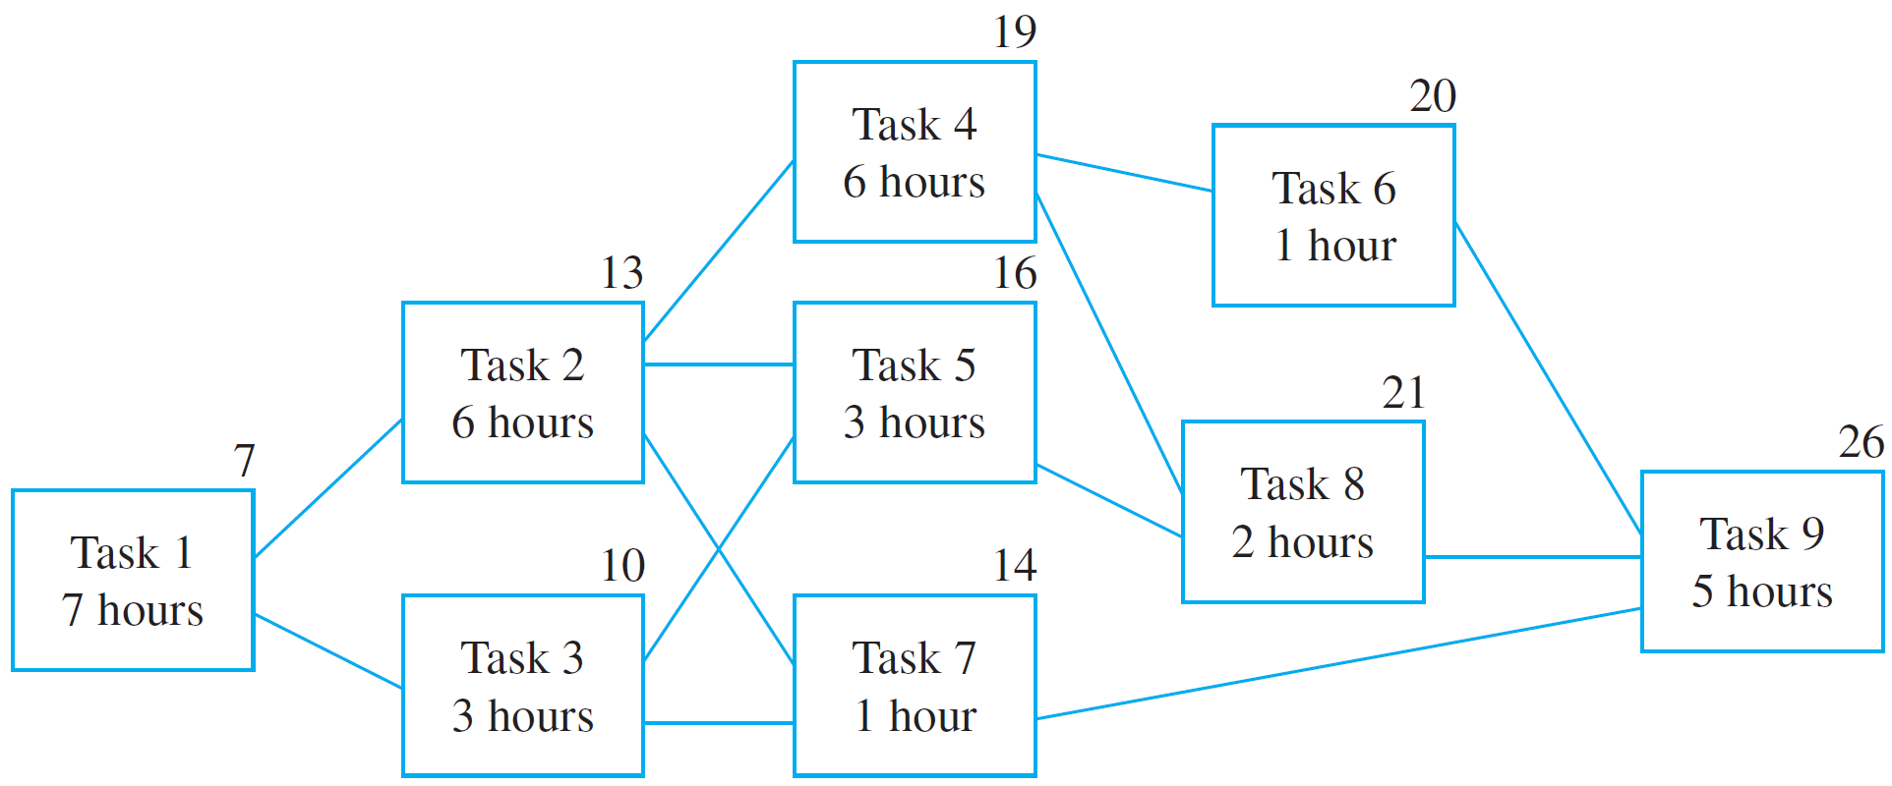
Example 12 – A Job Scheduling Problem
cont’d
Similarly, you can place a 19 above the box for task 4, a 20 above the box for task 6, a 21 above the box for task 8, and a 26 above the box for task 9, as shown below.

Slide 67
Example 12 – A Job Scheduling Problem
cont’d
This analysis shows that at least 26 hours are required to complete task 9 starting from the beginning of the assembly process. When task 9 is finished, the assembly is complete, so 26 hours is the minimum time needed to accomplish the whole process.
Note that the minimum time required to complete tasks 1, 2, 4, 8, and 9 in sequence is exactly 26 hours.
This means that a delay in performing any one of these tasks causes a delay in the total time required for assembly of the car.
For this reason, the path through tasks 1, 2, 4, 8, and 9 is called a critical path.

